Slide 1
Introducing XNA for WP7
Rob Fonseca-Ensor
Notes:
http://www.youtube.com/watch?v=I_U7YZwf2Nw
http://www.youtube.com/watch?v=ycli-koDlP8

Slide 2

Me
I help run the CWDNUG
I’m co-authoring a WROX book on WP7
I’ve got an iPhone game on the app store
I write Silverlight apps ALL DAY LONG (for Infusion)
www.robfe.com | rob@robfe.com | @robfe | meetup.com/cwdnug

Slide 3
What is it
.NET framework for games
XBOX, PC, Zune
Now WP7
Creator’s Club
http://creators.xna.com
Parallel set of .NET APIs
Even more cut down on WP7
Relatively Portable

Slide 4
When to use it
Silverlight is event driven
It reacts to the user
Suitable for some games
XNA is a game loop
The user reacts to the game
3D graphics
Performance

Slide 5
Running an XNA game
LoadContent
Game Loop
UnloadContent (Theoretically)
Initialize
Draw
Update
Notes:
Update is responsible for reading the state of the user input, network input and mutating the game state
Draw is responsible for reading the game state and rendering that to the screen

Slide 6
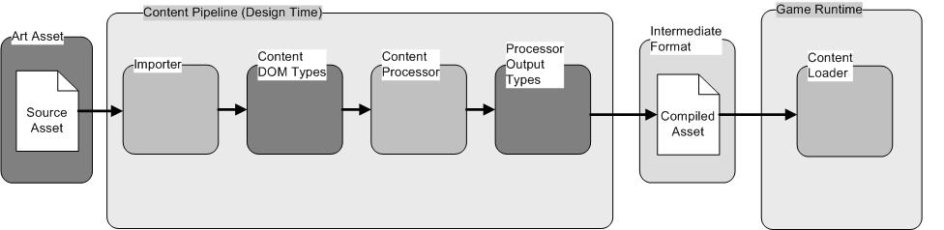
The Content Pipeline
http://msdn.microsoft.com/en-us/library/bb447745.aspx
Notes:
The content pipeline represents a huge boost in runtime-performance, portability and ease of development
It can take your fonts, and only include the glyphs you’d like. Images and sounds are compressed and optimised for the target device.
3D assets will be processed appropriately

Slide 7
2D drawing with the SpriteBatch
A class that manages the rendering of 2D sprites (textures) and fonts
Begin
Starts a batch
Draw
Paints a Texture2D to the screen
DrawString
Paints a SpriteFont + a string to the screen
End
Commit the batch

Slide 8
As time goes by
Track how quickly by inspecting the GameTime
Allows proportional movement
Ever tried to play a 286 game on a 66 MHz beast?
React to time passing within Update
Update is less likely to skip than Draw
You don’t want to miss a poll of some user input

Slide 9
Geometry APIs
Vector2
+ - * / another Vector2 or a float.
Normalize, Length, LengthSquared
System.Math
Math.ATan2(x,y) to calculate angles
Cos and Sin to turn an angle into a Vector2
MathHelper
The XNA Version of System.Math
Constants: PI, TwoPi, PiOverFour, E, Log10E
Methods: DegreesToRadians, Clamp, CatMullRom, Lerp

Slide 10
Reading User Input
GamePad
An XBOX relic
Check if the user is pressing “back” (exit or menu)
TouchPanel
GetState()
Picks up all the currently touched points
Each touch has an ID
ReadGesture()
Higher level API
Filter with EnabledGestures

Slide 11
Encapsulation with GameComponent
Update or Draw will get bigger as your game gets built
Separate responsibilities into components
Don’t treat these as sprites – they should be long-lived
Share state via Game.Services
GameComponent has parallel Initialize, LoadComponent, Update and Draw (DrawableGameComponent)

Slide 12
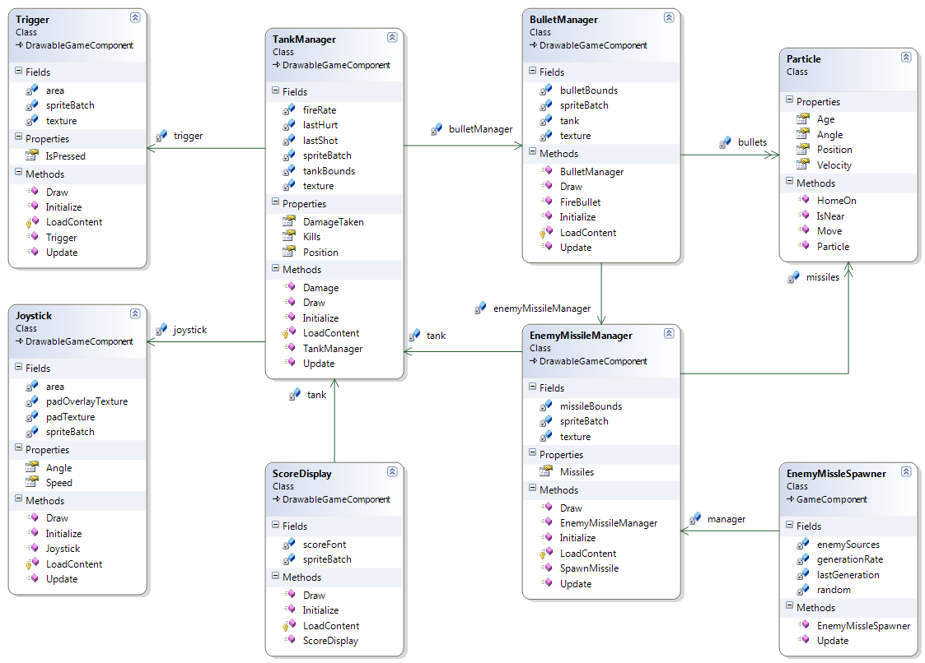
Notes:
My GameComponents, let me show you them

Slide 13
Questions?
www.robfe.com | rob@robfe.com | @robfe | meetup.com/cwdnug

